Slide 1
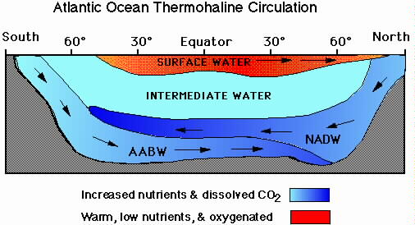
Water masses

Slide 2
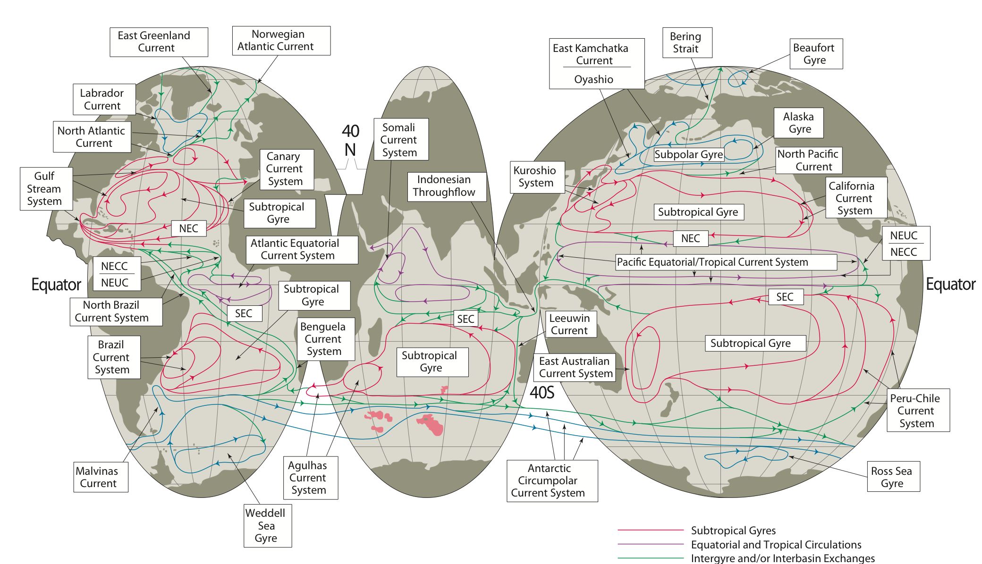
Upper ocean circulation
Gyres, western boundary currents, Antarctic Circumpolar Current, equatorial circulations
Notes:
Go back to typical structures lectures.

Slide 3
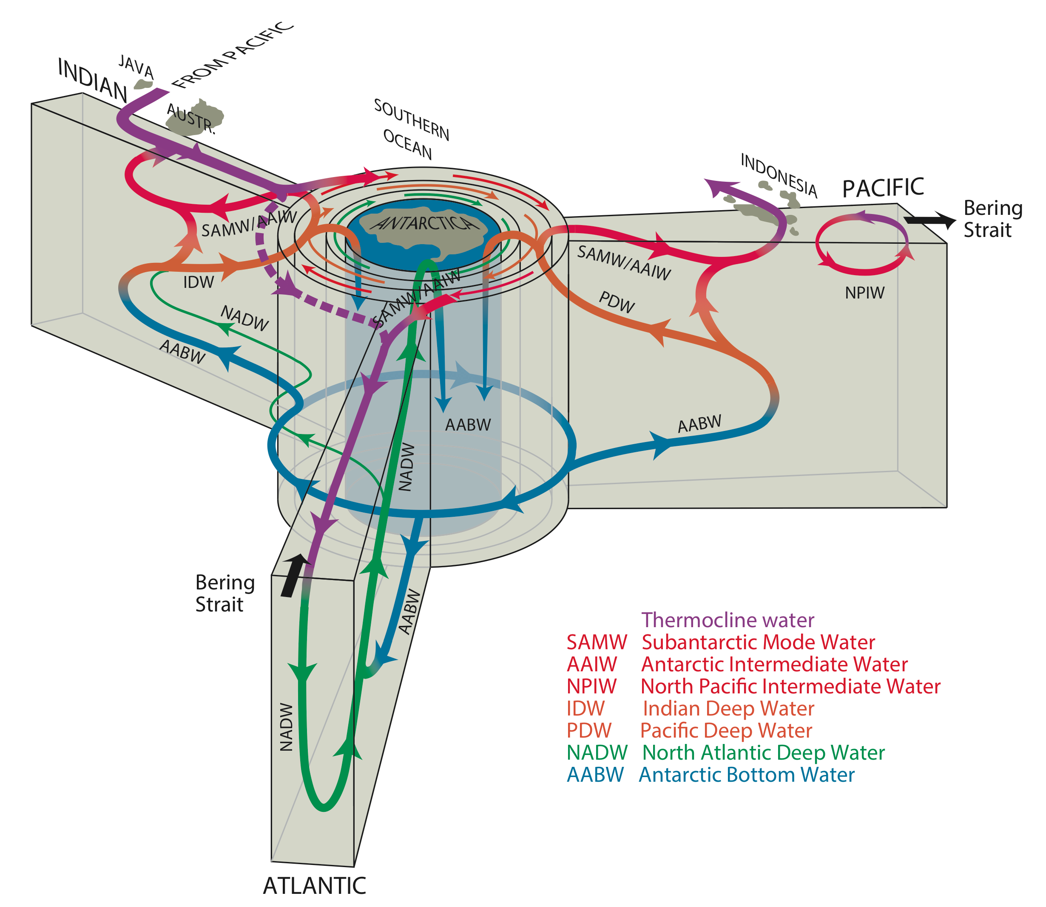
Processes for the Global Overturning Circulation
Brine rejection: Southern Ocean overturning circulation (AABW)
Wind-driven upwelling
Diffusive upwelling
Deep convection
N. Atlantic Meridional Overturning Circulation (AMOC) (NADW)
Talley (Oceanography, 2013)

Slide 4
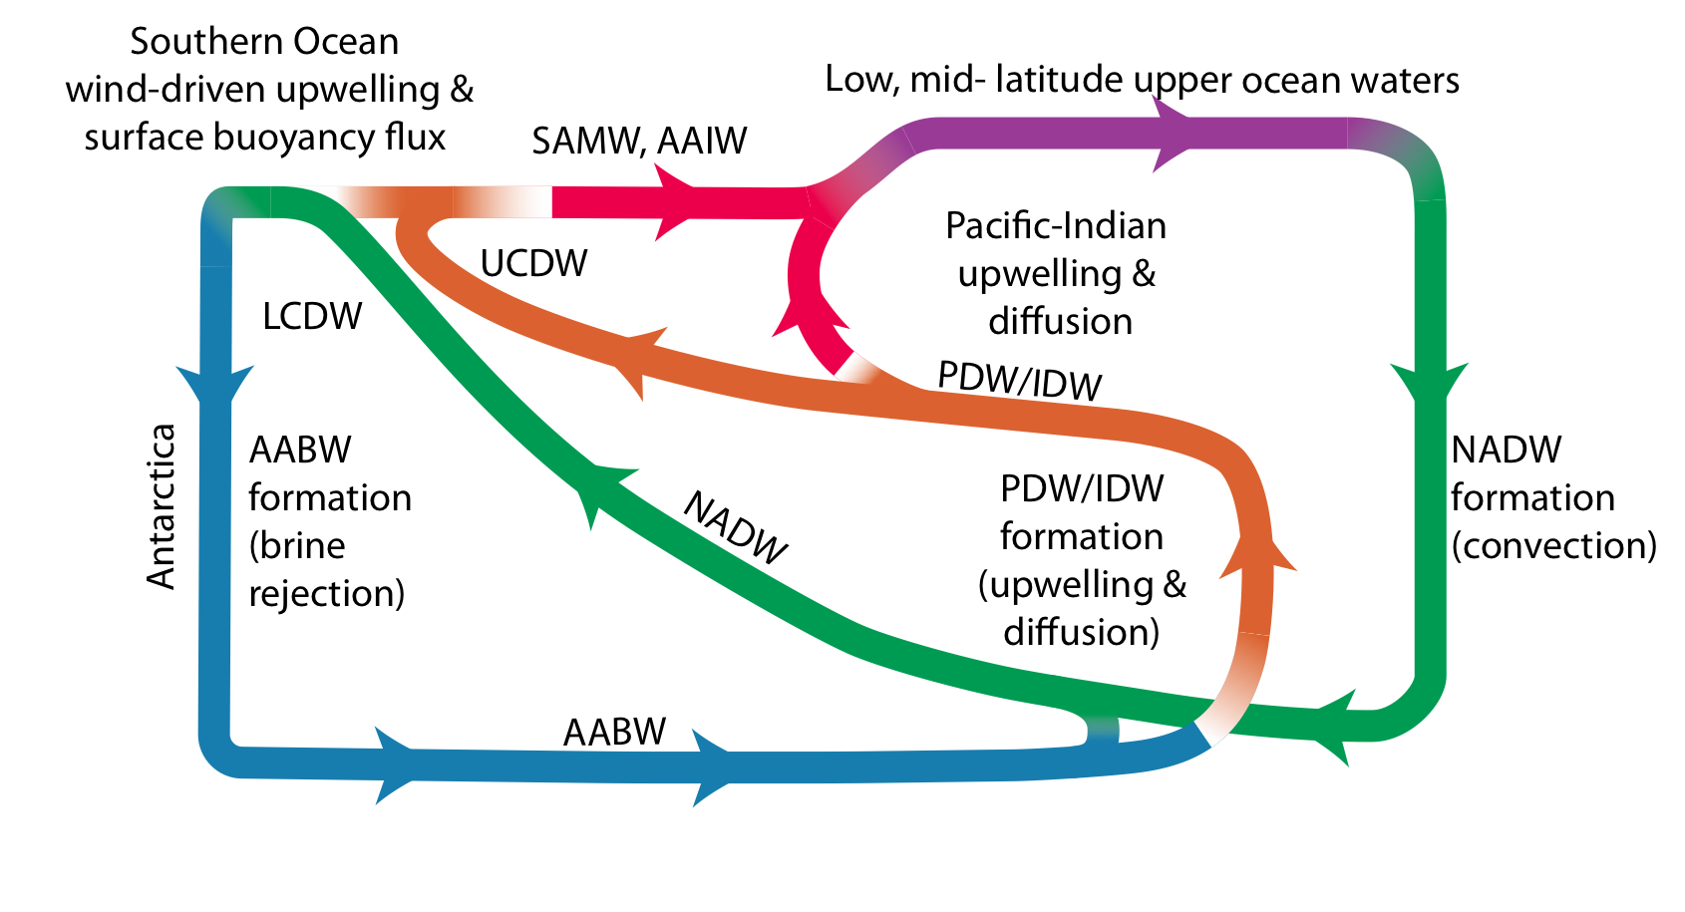
Global overturning in zonally-averaged view

Slide 5
Defining Characteristics
Conservative Properties- determined by boundary conditions
Temperature
Salinity
Non-conservative Properties- influenced by processes in the interior
i.e. oxygen, nutrients, carbon dioxide. These do not affect the classification of water masses.
Notes:
Requirement- No appreciable internal source or sink (hydrothermal vents, undersea volcanoes, radiation)
Temp- determined largely by the heat balance in the first 100 meters (mixed layer)
Salinity- balance of precip and evap, most important term in density
Non-conservative properties

Slide 6
An oceanographic water mass is an identifiable body of water which has physical properties distinct from surrounding water.
Properties include temperature, salinity and other physical quantities.
Common water masses in the world ocean are:
Antarctic Bottom Water (AABW),
North Atlantic Deep Water (NADW), Circumpolar Deep Water (CDW),
Antarctic Intermediate Water (AAIW)
the Central Waters (CW) of various ocean basins, and various surface waters.

Slide 7
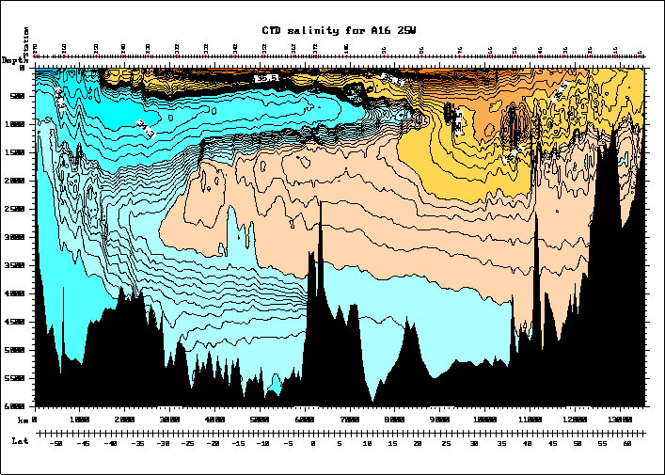

Slide 8
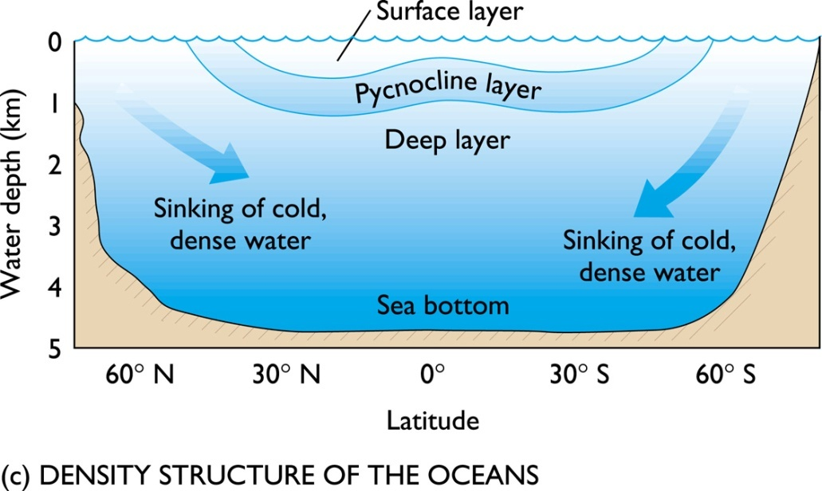
The water masses of the world's oceans can be summarised:
The warm water sphere and pycnocline make up only 20% of the total volume, but because they encompass the layers of greatest variation of T and S they dominate the T-S diagrams.
The deep and bottom waters vary little in T and S.

Slide 9
The deep and bottom waters vary little in T and S.
The upper layers vary significantly from one ocean to another because they are strongly affected by heat and water fluxes through the surface locally.
The deep layers vary much less between oceans.

Slide 10
Concept of a water mass
Below the surface layer which is in permanent contact with the atmosphere, temperature and salinity are conservative properties, ie they can only be changed by mixing and advection.
All other properties of sea water such as oxygen, nutrients etc. are affected by biological and chemical processes and therefore non- conservative.
Water masses can therefore be identified by their temperature-salinity (T-S) combinations

Slide 11
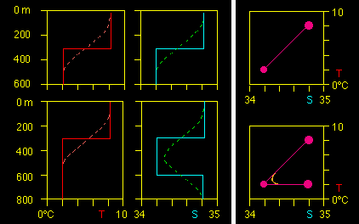
Temperature and salintiy profile = TS diagram
Layering of three water masses (intrusion of a low salinity water mass at 300 - 600 m depth). The full lines = before mixing, the broken lines after mixing.
The TS- diagram shows two mixing lines; the erosion of the intermediate salinity
minimum by mixing is seen by the departure of the broken curve from the original water mass point.

Slide 12
SO WHY DO WE CARE?
Differences in solar influx
↓
Pole-Equator temperature gradient
Differences in evaporation and precipitation
↓
Meridional heat and salinity transport
↓
Facilitated by Atmosphere & Ocean
↓
Circulation characteristics influence climate
Notes:
EARTH IS SPHERICAL - POLES GET LESS RADIATION BECAUSE OF ANGLE OF INCIDENCE.
RESULTANT GRADIENT CAUSES DIFFERENCES IN EVAPORATION AND PRECIP AND THEREFORE SALINITY
ANY NATURAL SYSTEM DRIVES ITSELF TO EQUILIBRIUM - TRANSPORT OF T AND S
ATMOSPHERIC CIRC PRIMARILY BUT ALSO OCEANIC TRANSPORT.
INFLUENCE CLIMATE (T, PRECIP, EVAP)

Slide 13
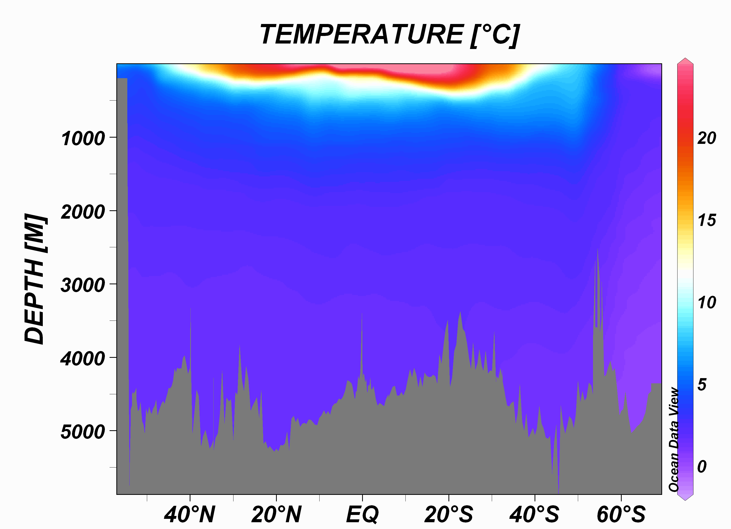

Slide 14
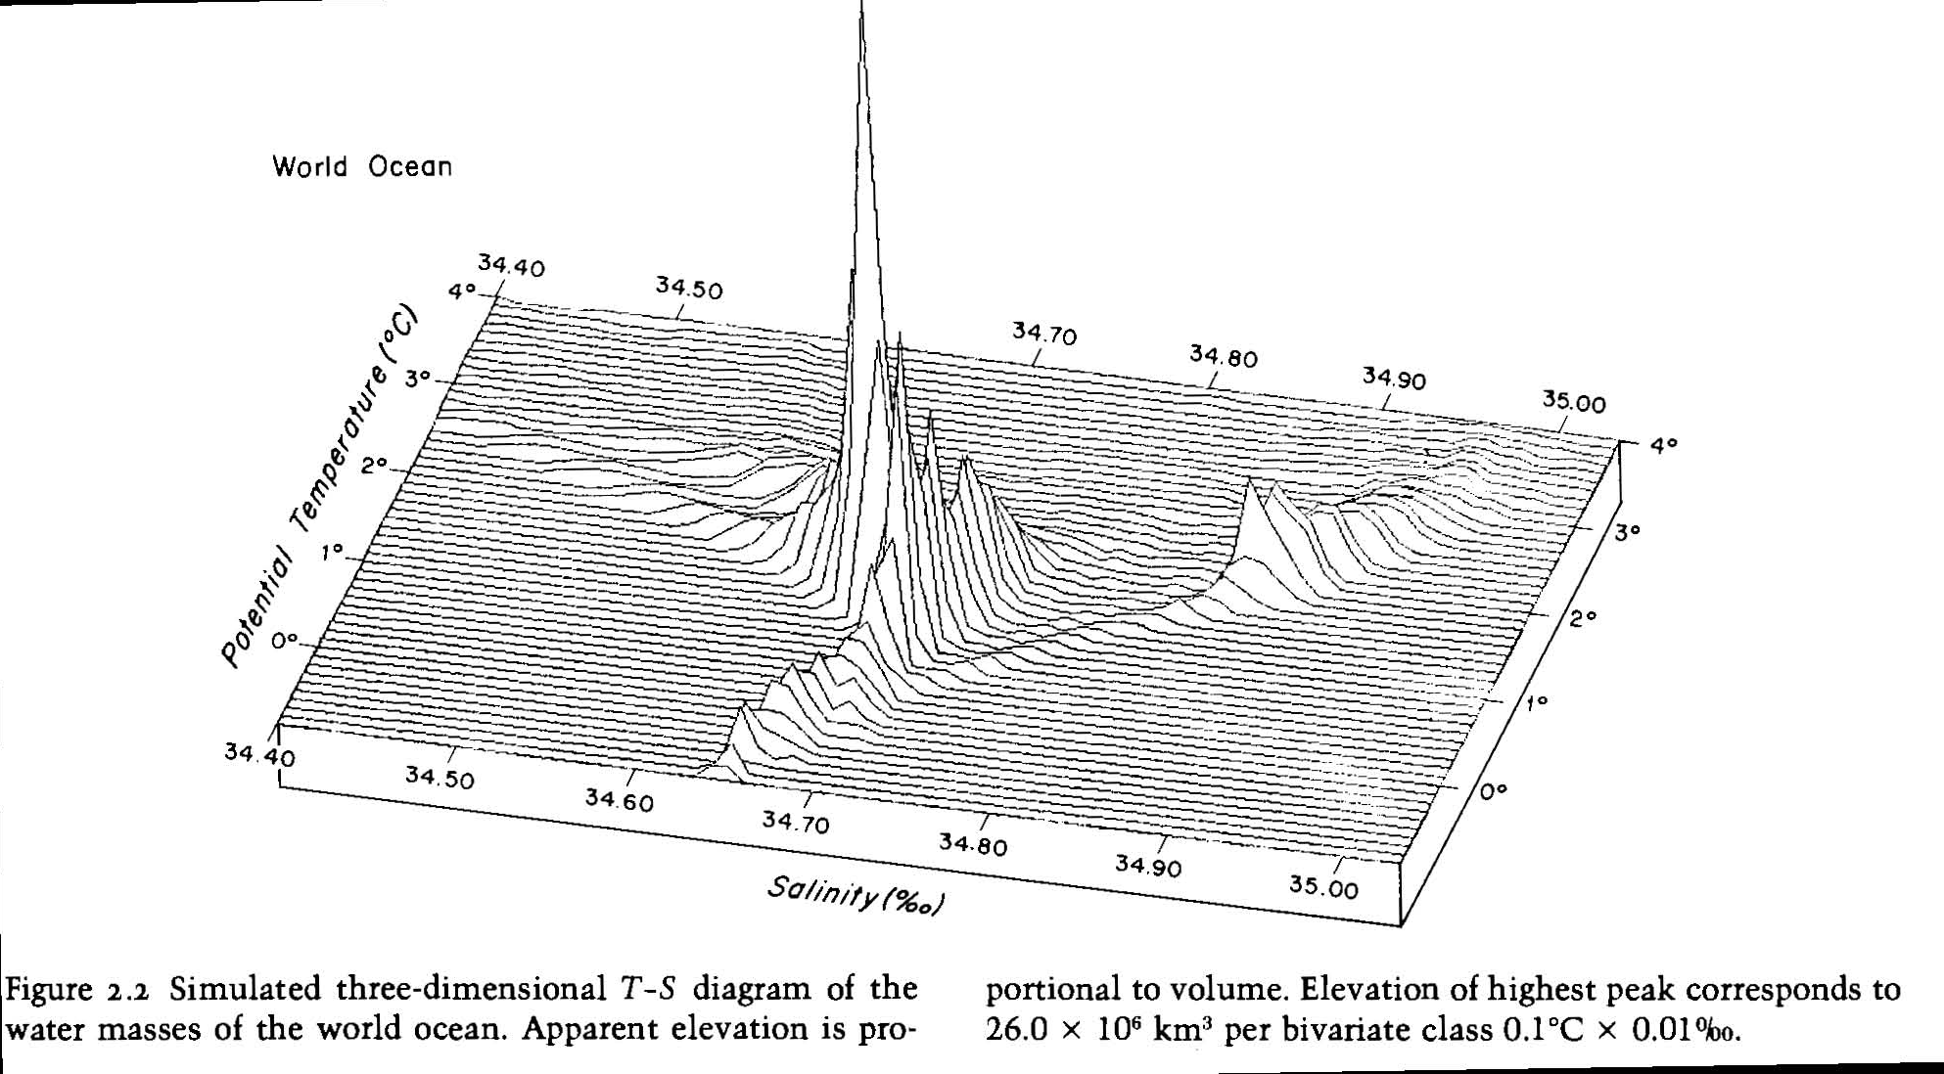
Global deep water potential temperature-salinity
Worthington, 1982
4°C
0°C
North Atlantic Deep Water
Pacific Deep Water
Indian Deep Water
Antarctic Bottom Water

Slide 15
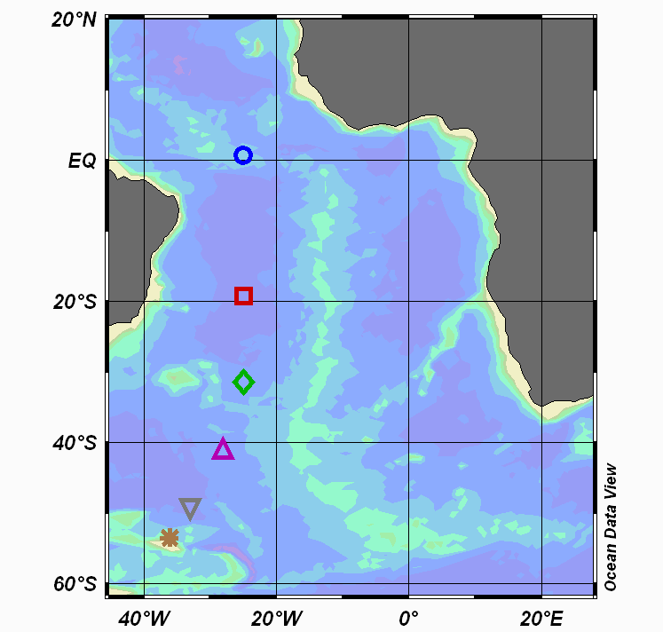

Slide 16
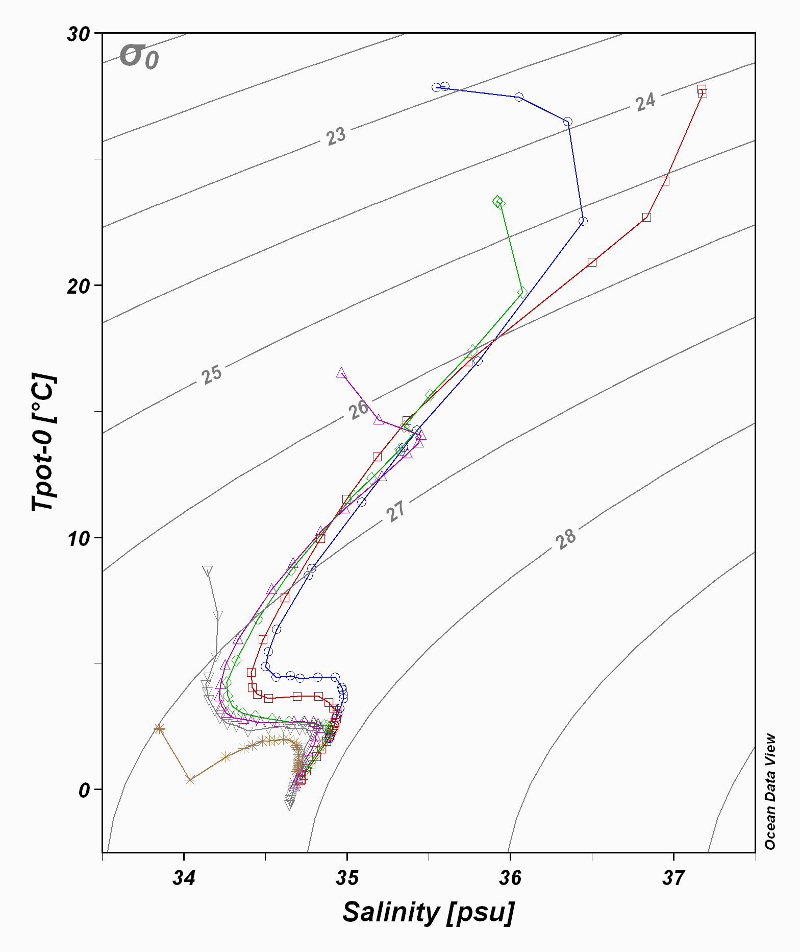

Slide 17
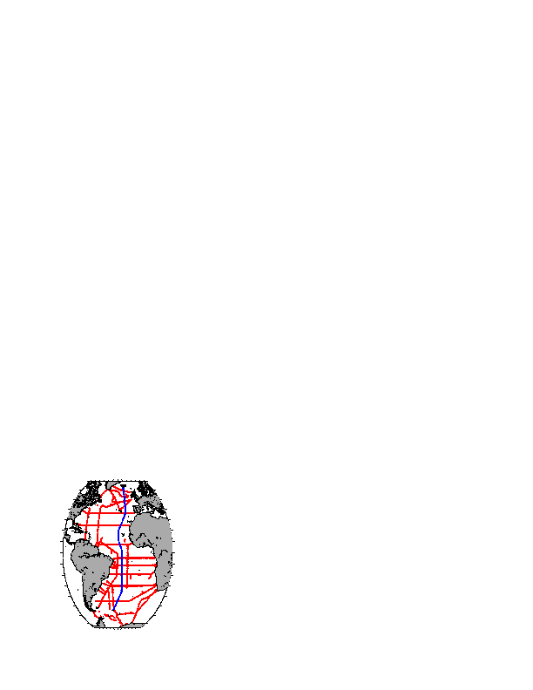
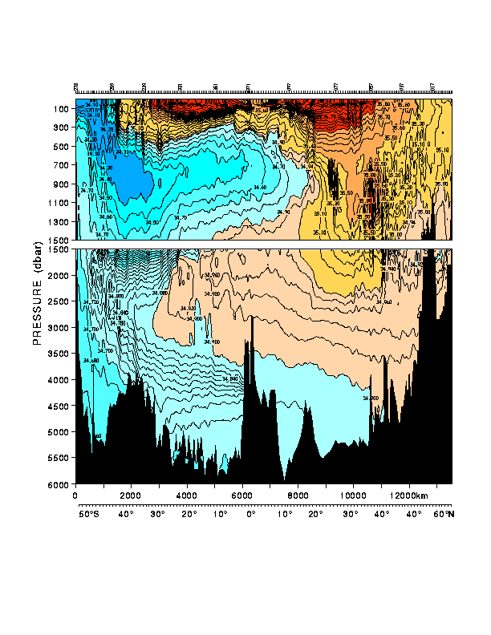
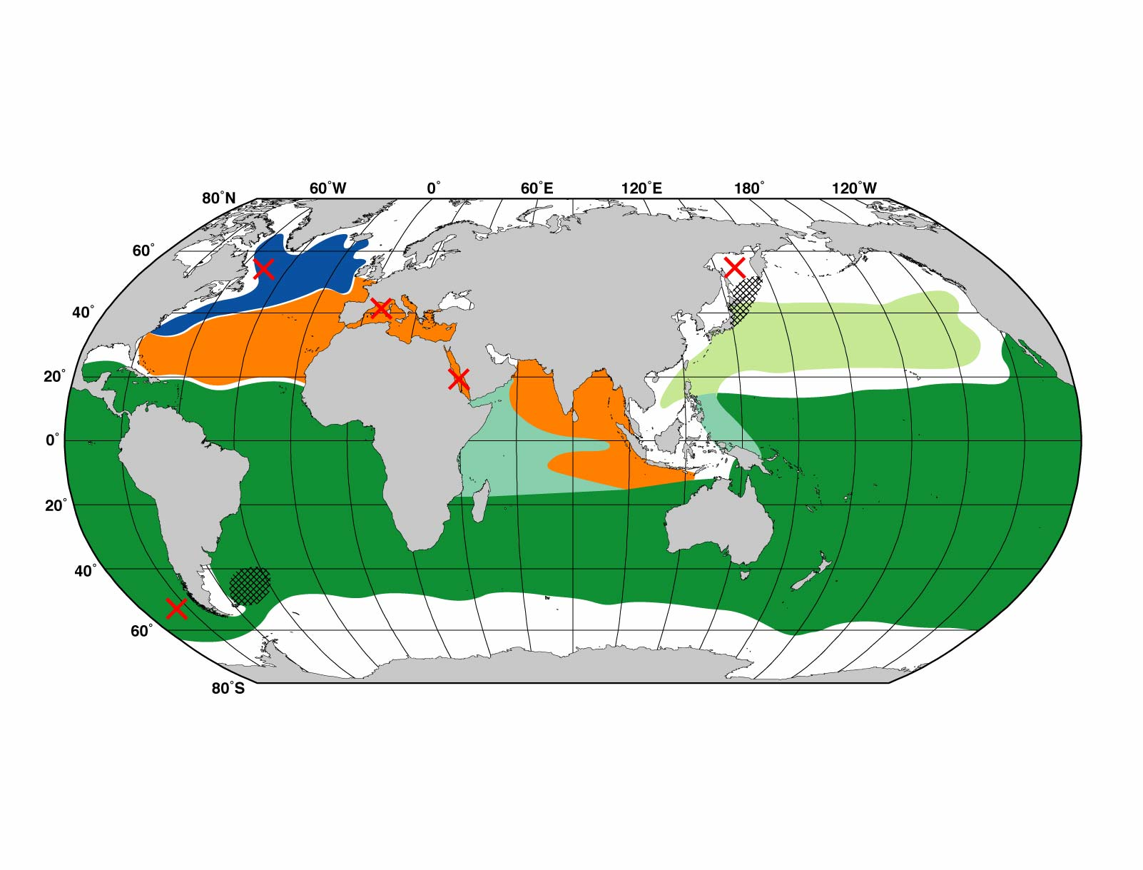
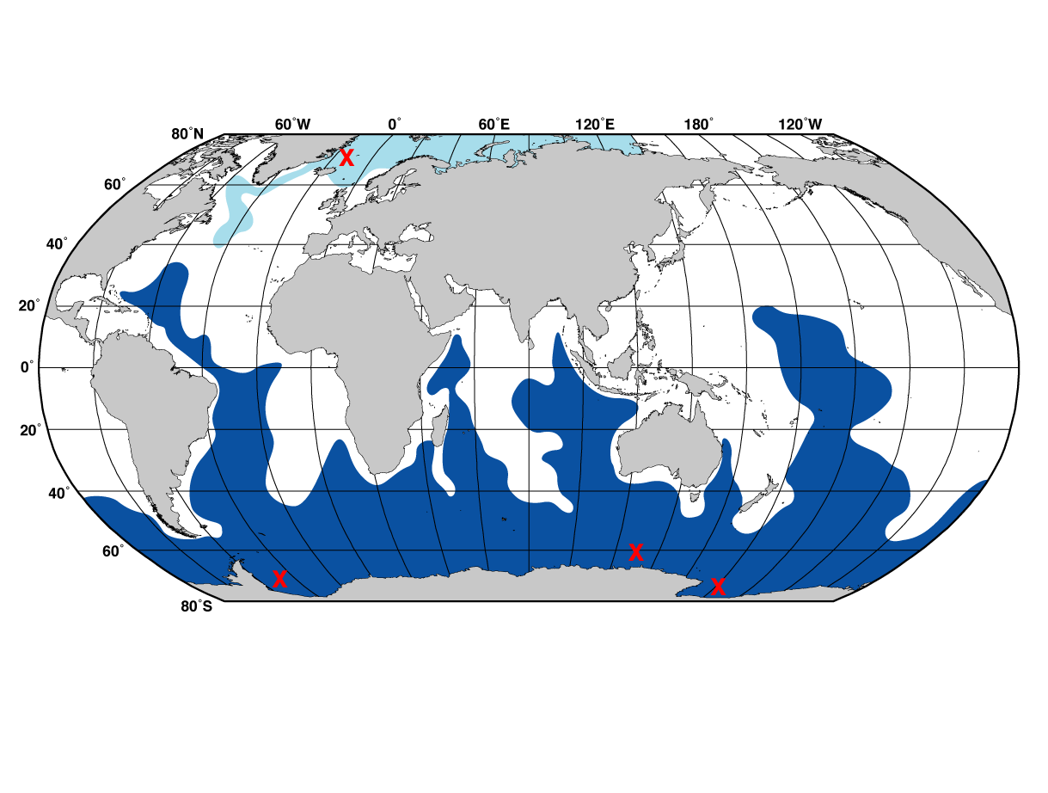
Atlantic Salinity (south-north section)
(1) surface waters (ventilated thermocline)
(1)
(2) Low salinity Antarctic intermediate water
(2)
(3)
(3) High salinity
North Atlantic Deep Water
(4)
(4) Low salinity Antarctic bottom water
30°S
24°N

Slide 18
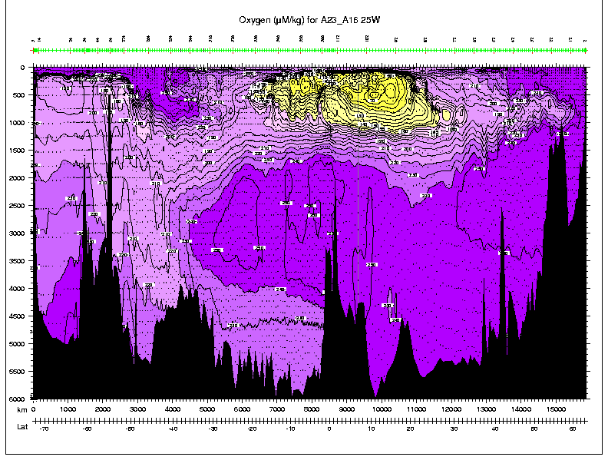
Oxygen in the Atlantic at 25W
(1)
(1) Upper
(2) AAIW and LSW
(3) NADW
(4) AABW
(2)
(3)
(4)

Slide 19
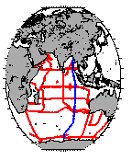
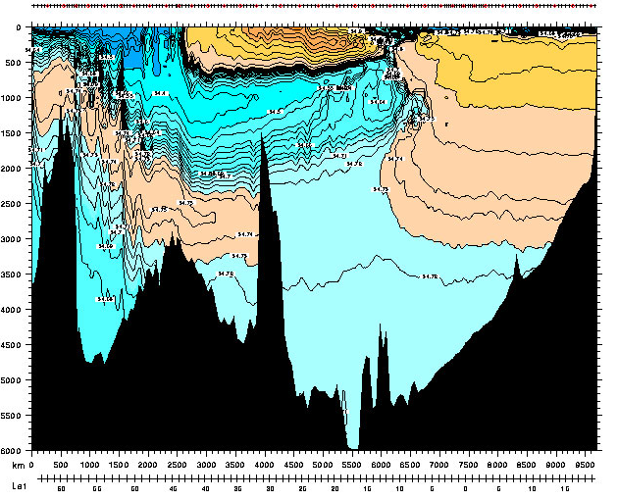
Eastern Indian water masses
(1)
(2)
(2)
(3)
(1) Upper
(2) AAIW and RSW
(3) NADW and IDW
(4) LCBW (AABW)
(3)
(4)
32°S

Slide 20
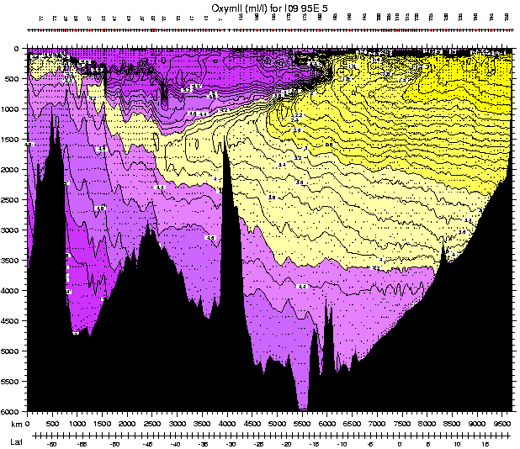
Eastern Indian water masses: oxygen
(1)
(2)
Lower oxygen: Red Sea Water and other northern Indian waters
(3)
(4)
Higher oxygen- Subantarctic Mode Water and Circumpolar Deep Water
32°S

Slide 22
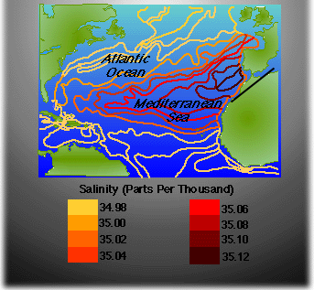
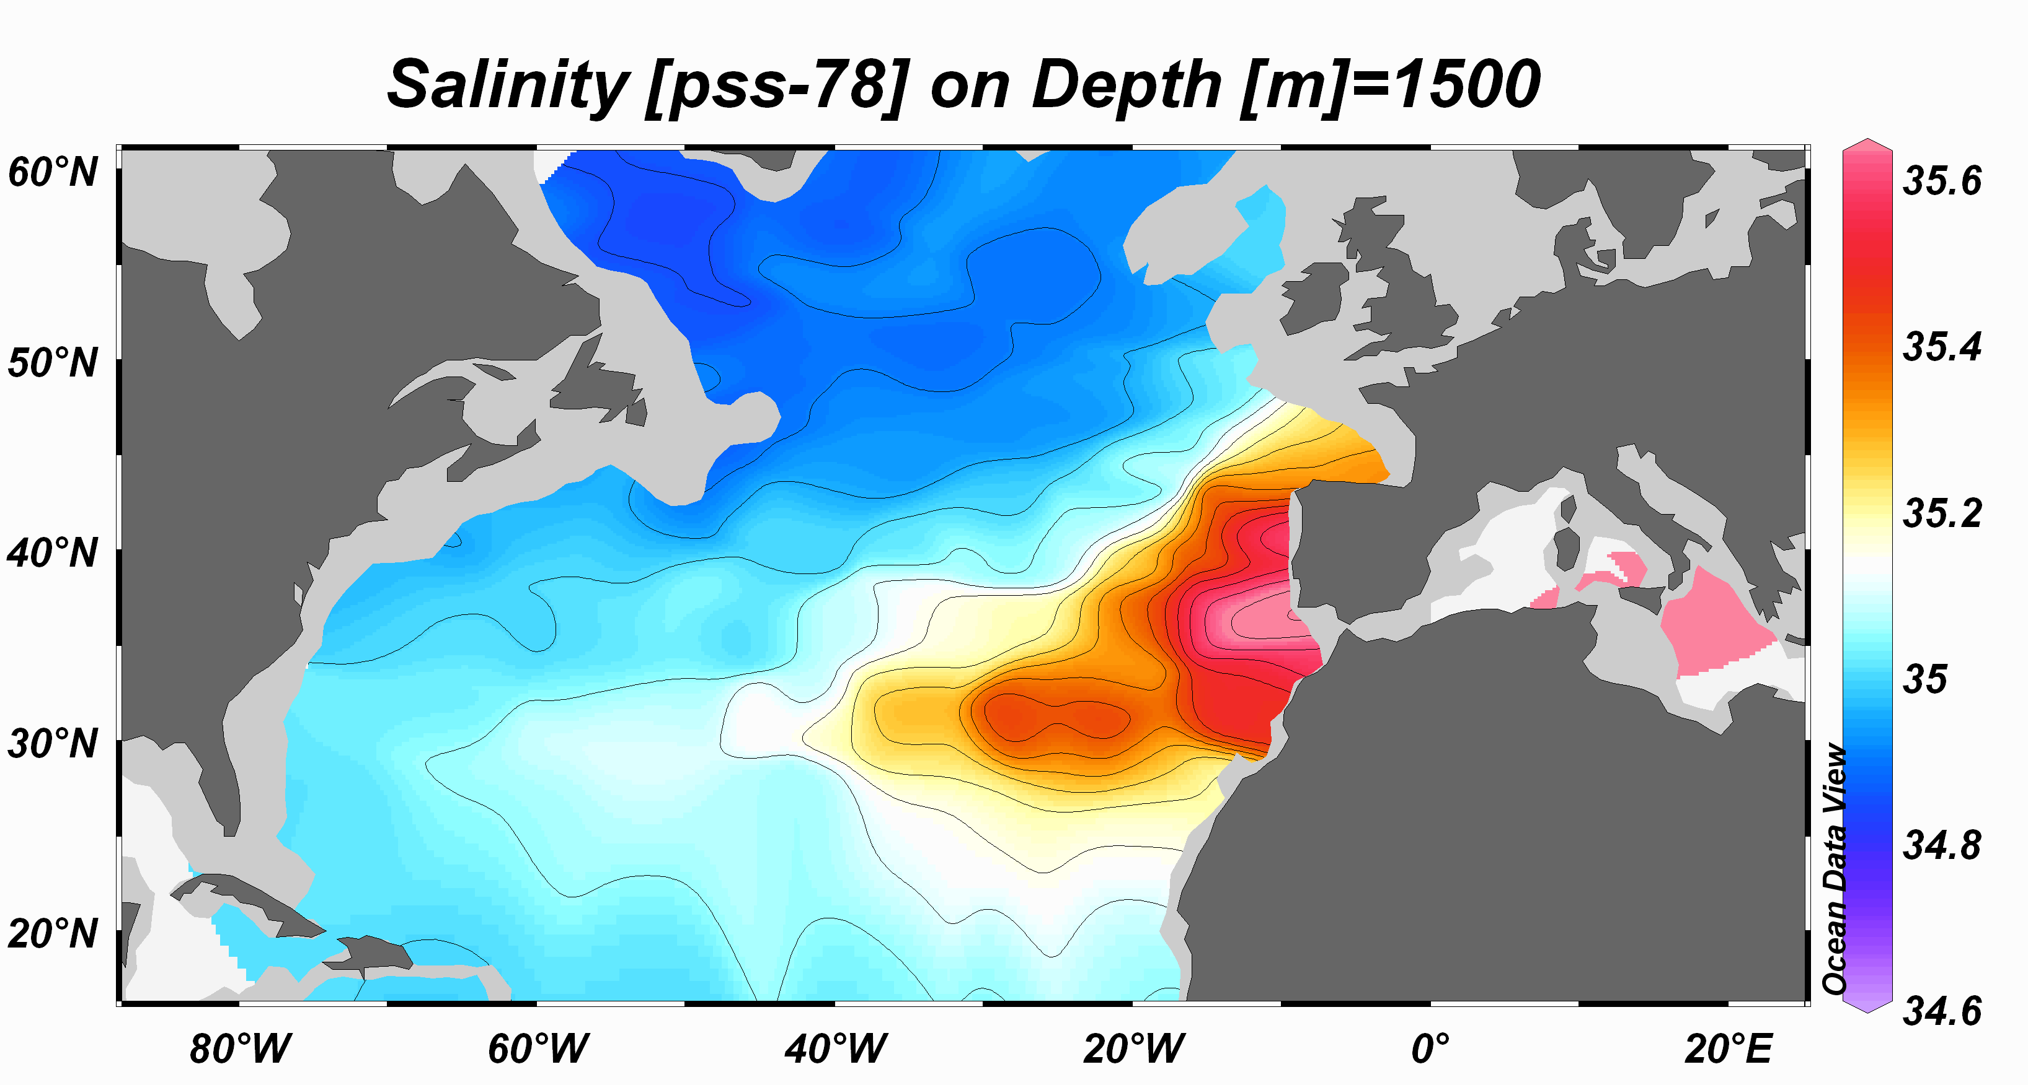

Slide 24
Subtropical
Surface

Slide 25
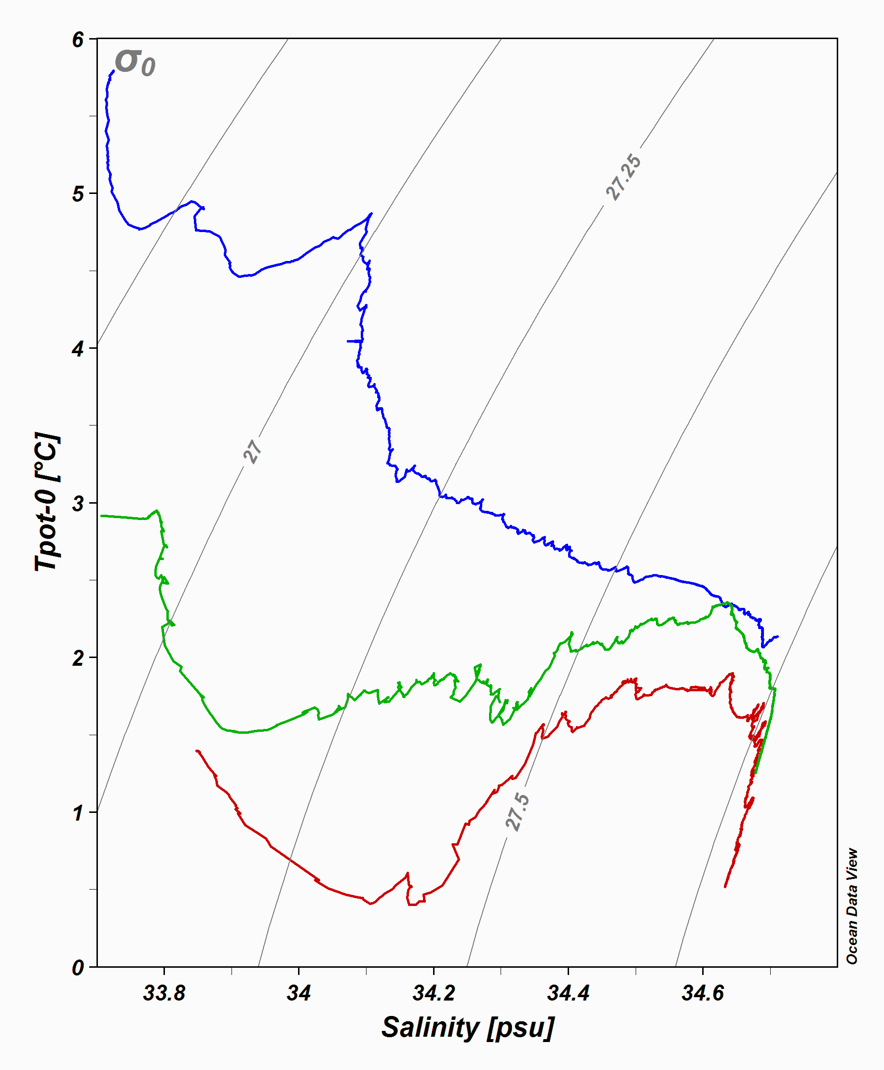
Notes:
19
Can do in-class exercise with SO winds and convergence/divergence to explain AAIW

Slide 26
Notes:
19
Can do in-class exercise with SO winds and convergence/divergence to explain AAIW

Slide 27
Notes:
19
Can do in-class exercise with SO winds and convergence/divergence to explain AAIW

Slide 28
Water mass
Surface/ Upper layer: ventilated thermocline. Includes Mode Waters, Central Water, subtropical Underwater (salinity maximum water)
Intermediate layer: Labrador Sea Water, Mediterranean Overflow Water, Red Sea Water, North Pacific Intermediate Water, Antarctic Intermediate Water
Deep layer: North Atlantic Deep Water, Pacific Deep Water (also known as Common Water), Indian Deep Water, Circumpolar Deep Water
Bottom layer: Antarctic Bottom Water (aka Lower Circumpolar Deep Water)
Remember these layer numbers!

Slide 29
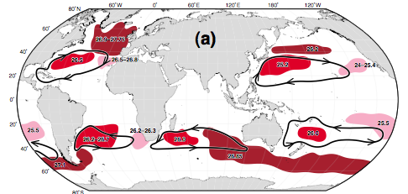
(1) Upper ocean water masses
Central Waters (main subtropical thermocline, derived from broad subduction of subtropical surface waters) (not illustrated here)
Subtropical Underwater (ST gyre, shallow salinity maxima, derived from subduction of saltiest ST surface water) (not illustrated here)
Mode Waters (upper ocean, thick layers) (figure)

Slide 30
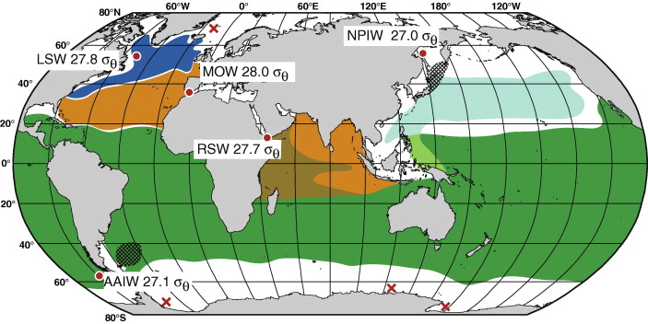
(2) Intermediate water summary
Low salinity: Labrador Sea Water, North Pacific Intermediate Water, Antarctic Intermediate Water
High salinity: Mediterranean Water, Red Sea Water

Slide 31
(3, 4) Deep water partial summary
(3) Nordic Seas Overflow waters, contributing to NADW
(4) Antarctic Bottom Water in Weddell, Ross Seas and Adelie Coast

Slide 33
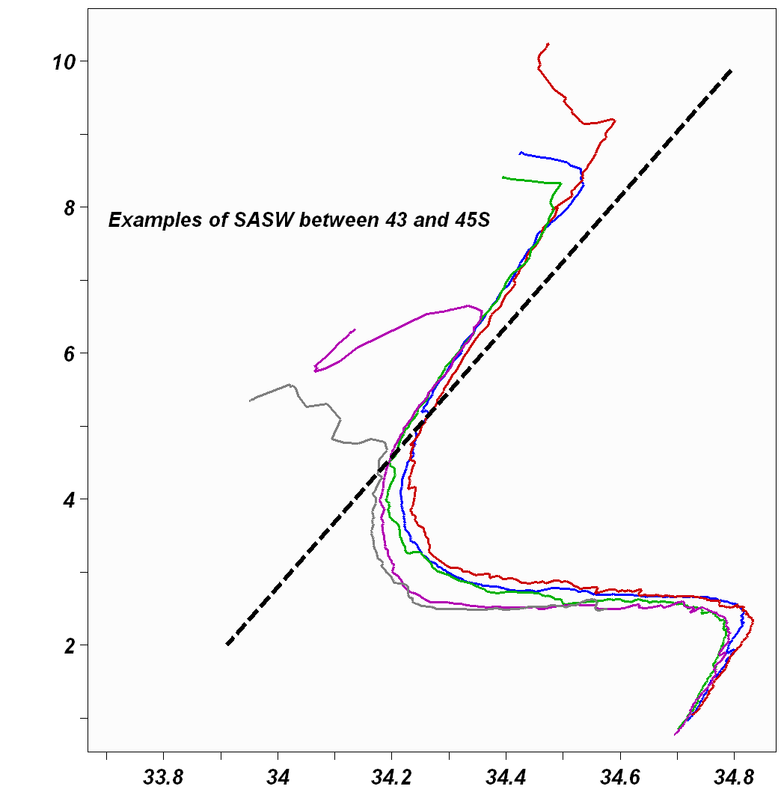
CASE STUDY - Water masses associated with the Southern Ocean
Subantarctic Surface Water (SASW).
SASW can be found lying between the STC to the north and the APF to the south.
SASW extends from the surface to the depth at which Antarctic Intermediate water lies. This depth ranges from 200 m - ~900 m.
Temperature ranges 4º – 10ºC and salinity ranges 33.9 – 34.9
SASW is strongly influenced by both climatic and regional oceanographic conditions:
CLIMATIC – It is characterised by a subsurface salinity maximum (150m), as a result of the large scale of precipitation over evaporation in these latitudes (40º – 50ºS).
REGIONAL – SASW is strongly influenced by mixing with adjacent gyres. The Agulhas Return Current system results in the SASW being more saline (0.05) in the SW Indian Ocean than in other regions of the Southern Ocean.

Slide 34
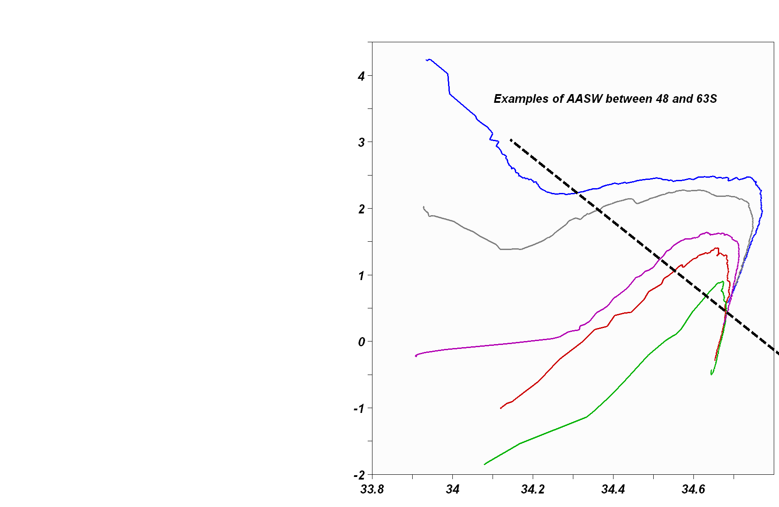
Antarctic Surface Water (AASW).
AASW can be found I the top 200 m south of the APF.
AASW is formed by the ascent of Circumpolar deep Water from depths of 2000m. This ascent results in an increase in surface temperatures and salinity. However, salinity levels are counter-balanced by the melting of sea ice.
AASW is characterised by a subsurface temperature minimum associated with the remnants of Winter Water. This temperature minimum lies in the top 200 m and ranges –1.8º –2ºC.
AASW is seasonally variable:
In winter- it is a nearly homogenous water mass extending to 250m. Temperature increases with distance north from near freezing at the AAD to 2C at the APF.
In Summer – the mixed layer extends between 50 –100m. Temperatures increase from –1.8ºC – 6ºC. Salinities are slightly lower due to ice melt 33.4 – 34.2

Slide 35
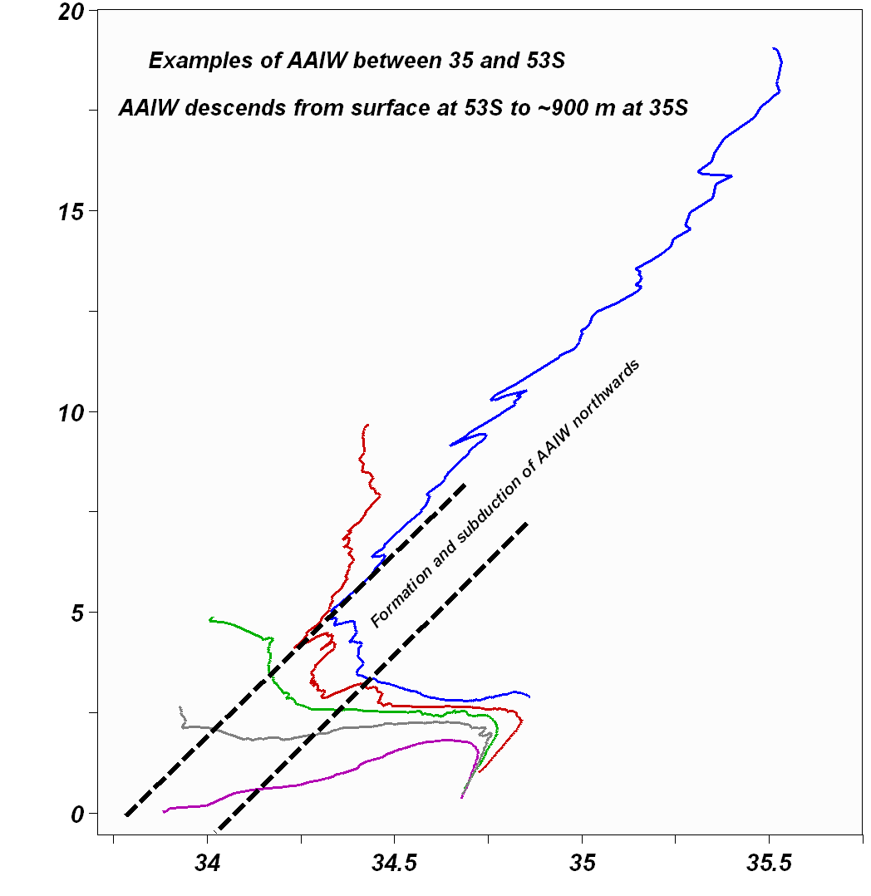
Antarctic Intermediate Water (AAIW).
AAIW is formed by the sinking of AASW at the APF.
From its place of origin it moves northwards into the subtropical zone along western boundaries, sinking beneath warmer Subantarctic and Subtropical; water masses to a maximum depth of 1000m.
Its characteristic core indicators are a salinity minimum of 33.8 – 34.3 as precipitation exceeds evaporation in these latitudes. It is also characterised by a temperature minimum of between 2 - 5ºC and an oxygen maximum of >6 ml/l

Slide 36
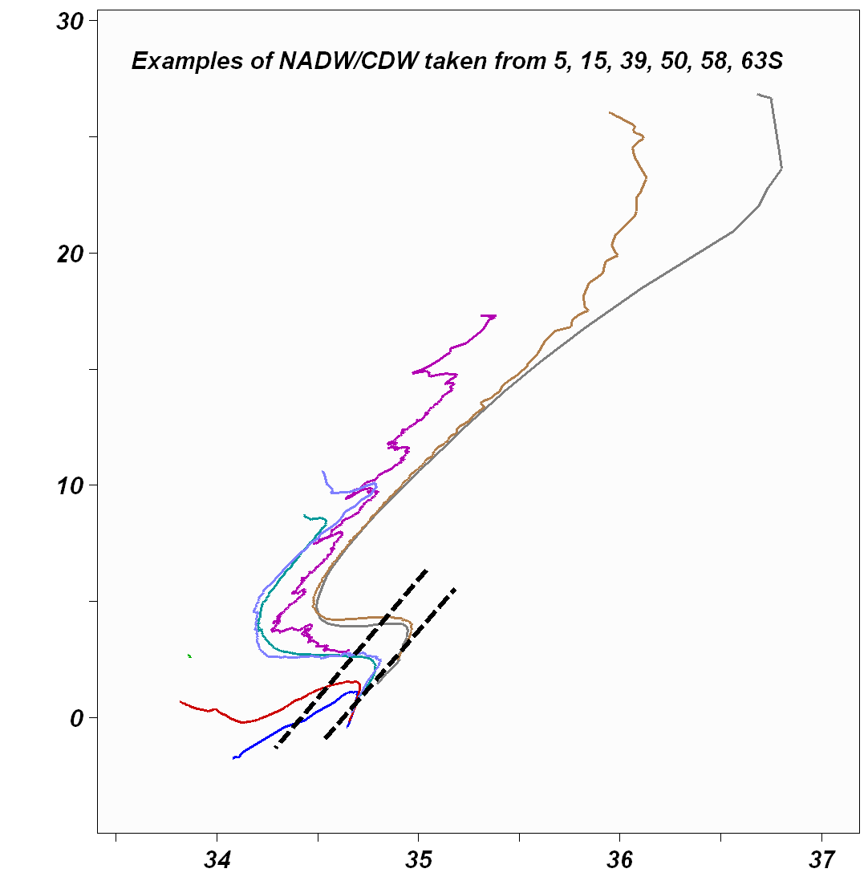
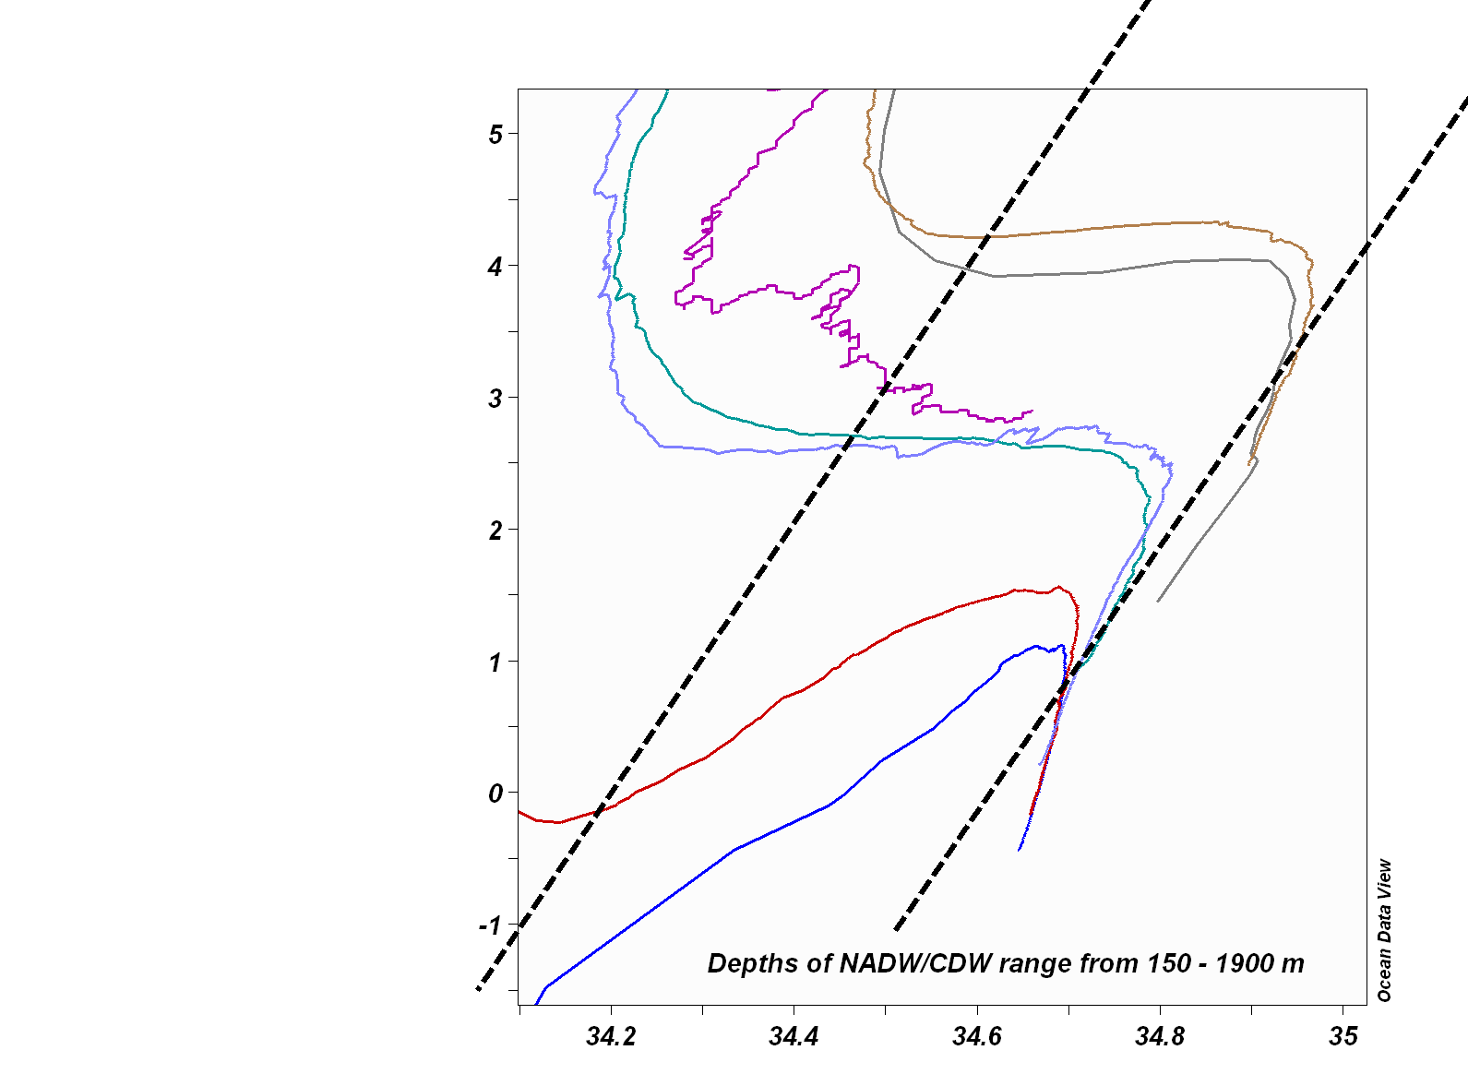
Circumpolar Deep Water (CDW).
Lying between AAIW and AABW and over 2000 m thick, this is the most voluminous water mass in the Southern Ocean, accounting for over 58% of all water in this region.
CDW flows southwards having been derived from North Atlantic deep Water and ascends to the surface at the AAD, where it warms the surface resulting in increased ice melting.
CDW forms AASW at the surface.
CDW is characterised by 2-3ºC and a high salinity of 34.7.
High salinities are due to the influence NADW has on the formation of CDW, in particular the saline outflow from the Mediterranean (>35.5).
CDW is divided into a lower LCDW and an upper UCDW water mass.
UCDW = centred at 1800 m. It is distinguished by an oxygen minimum (<4.25 ml/l).
LCDW = centred at 2500 and is characterised by a salinity and oxygen maxima (>4.75 ml/l) derived from NADW.

Slide 37
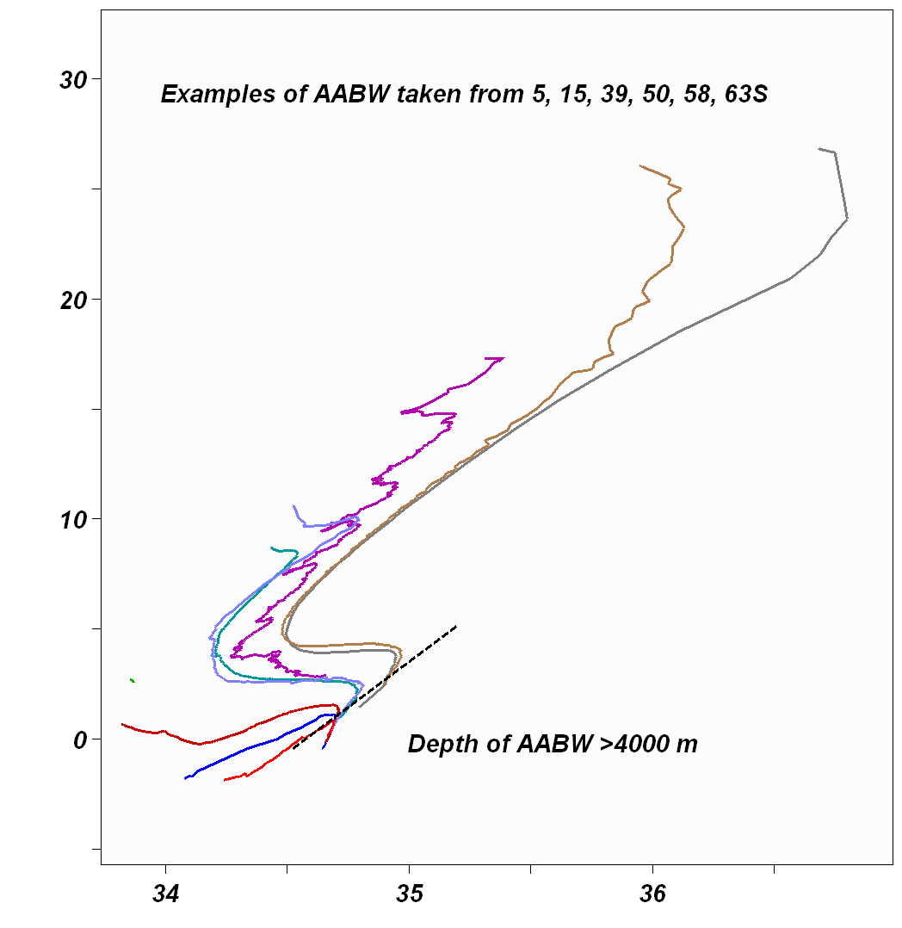
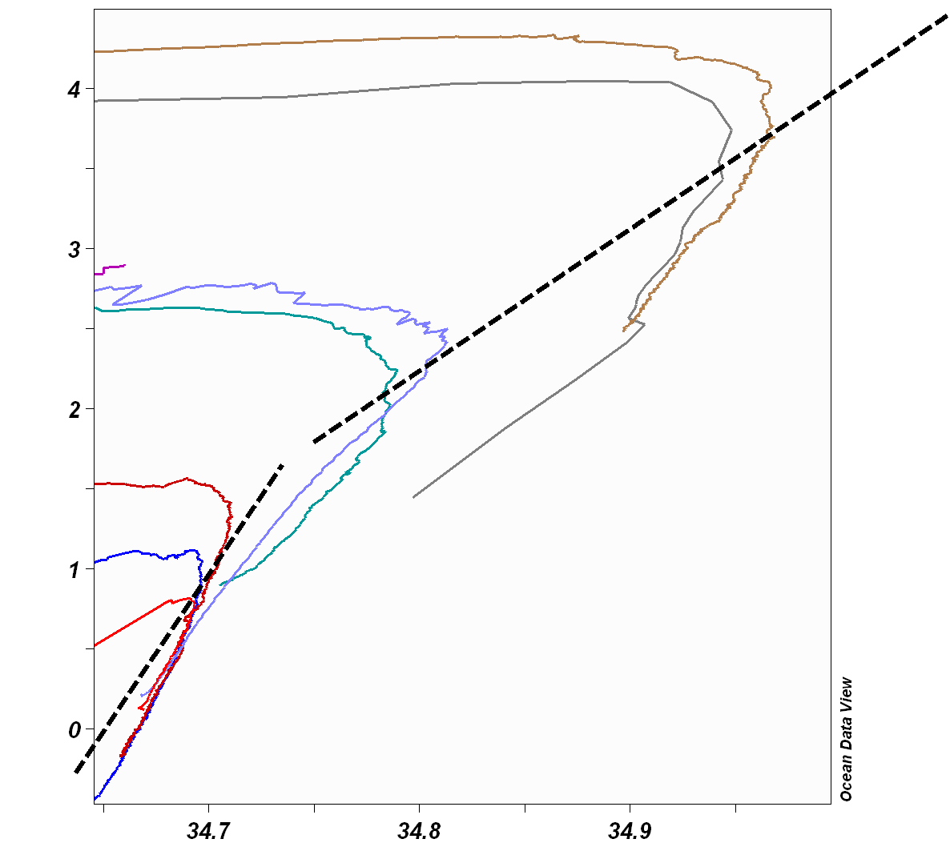
Antarctic Bottom Water (AABW)
The production of AABW is strongly controlled by atmospheric wind forcing by the easterly and katabatic winds that blow from the continent.
AABW is a mixture of warm saline CDW and cold ice shelf water from the Weddell Sea.
It is a very cold (<-0.5ºC), low salinity (<34.75) water mass.
Because it is so cold, it is also the densest water mass (27.9 kgm³) and consequently it flows down the Antarctic continental shelf and flows along the sea floor.
It is approx. 1100 m in width.
Distribution of AABW is influenced by the ACC, which carries this water mass eastwards. During its path it mixes with warmer overlying CDW and warms considerably with distance away from the continent. Temperatures range from –0.9ºC at the continental shelf to –0.4ºC southwest of Australia to 0.4ºC in the Drake Passage.
Its northward spread is restricted by topography especially in the Atlantic and Indian Oceans where the mid-ocean ridges hamper its path. However, deep fissures in these ridges such as the Romanche Deep allow AABW to filter through.

Slide 38
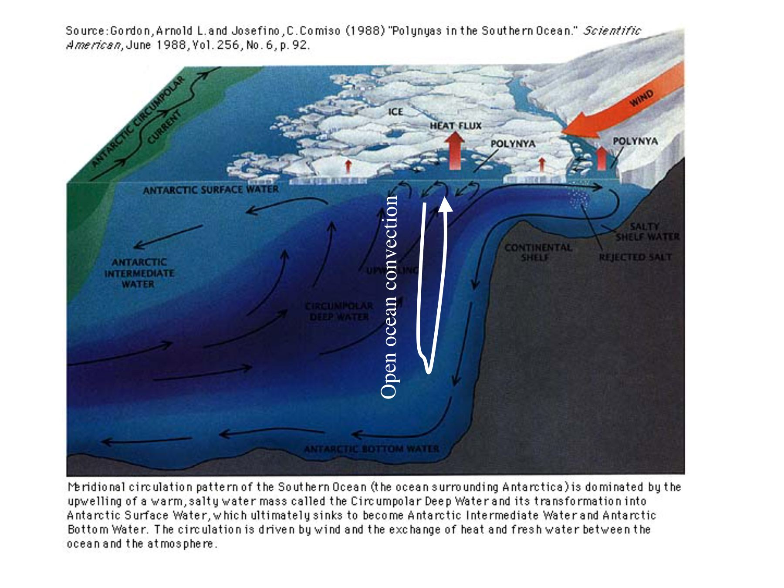

Slide 39
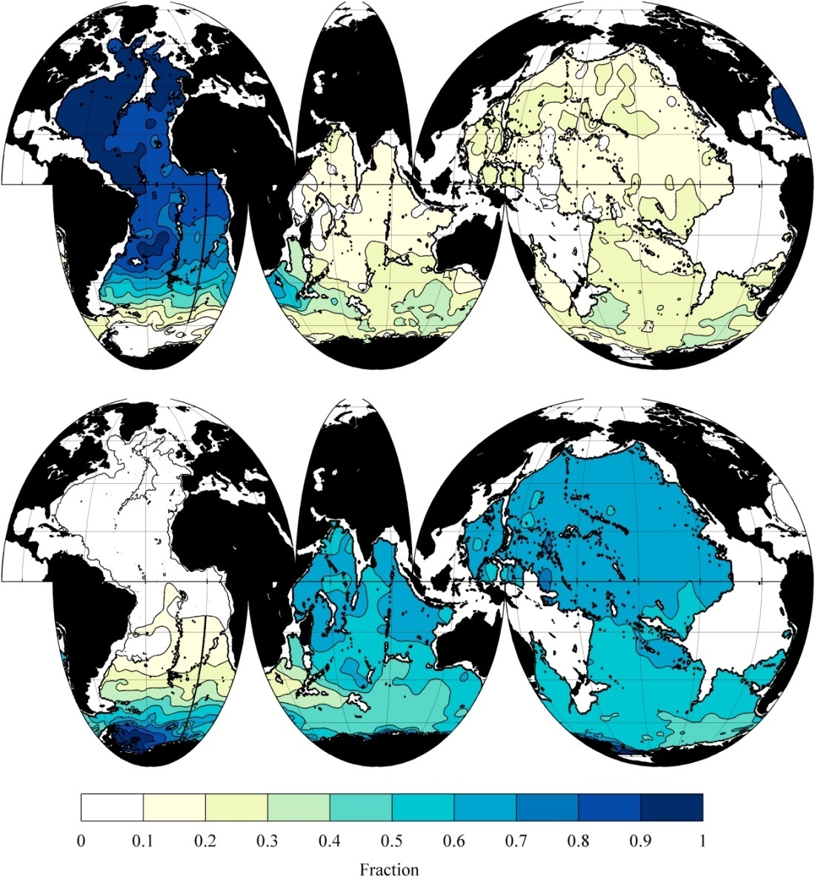
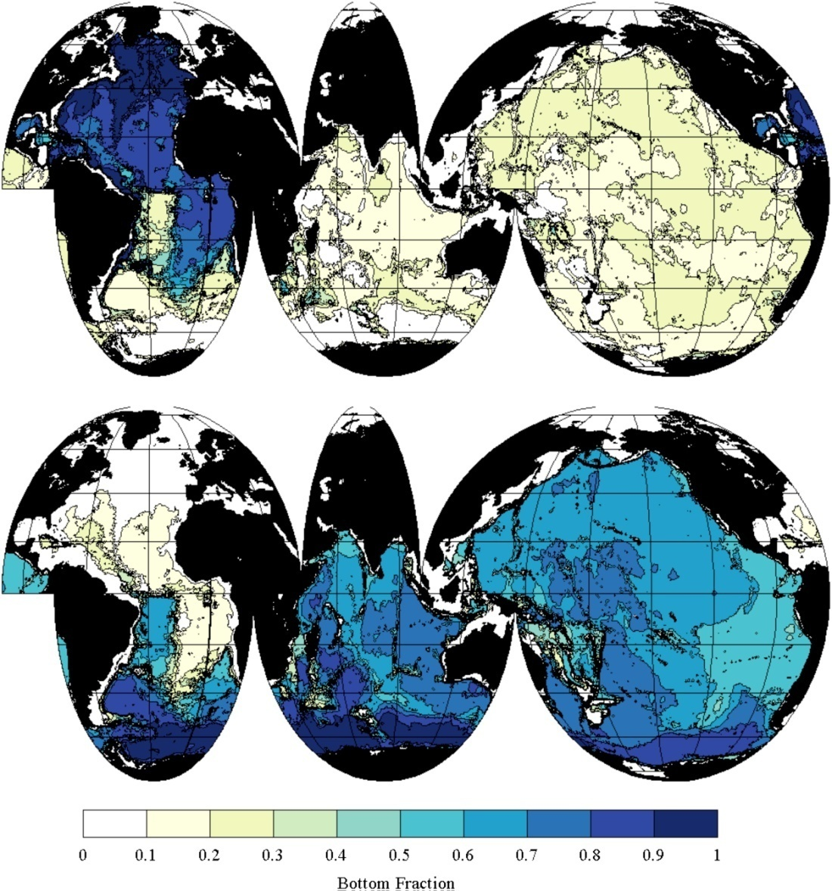
Fraction of NADW vs. AABW
At about 2500-3000 m
At the bottom
Johnson (2008) in DPO Figs. S14.4 and S14.5 (partially in fig. 14.15)

Slide 40
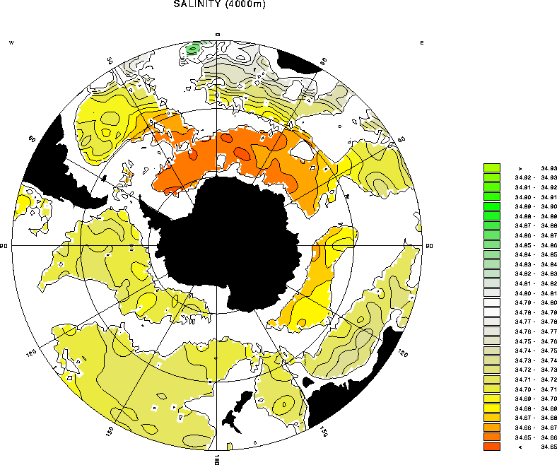

Slide 41
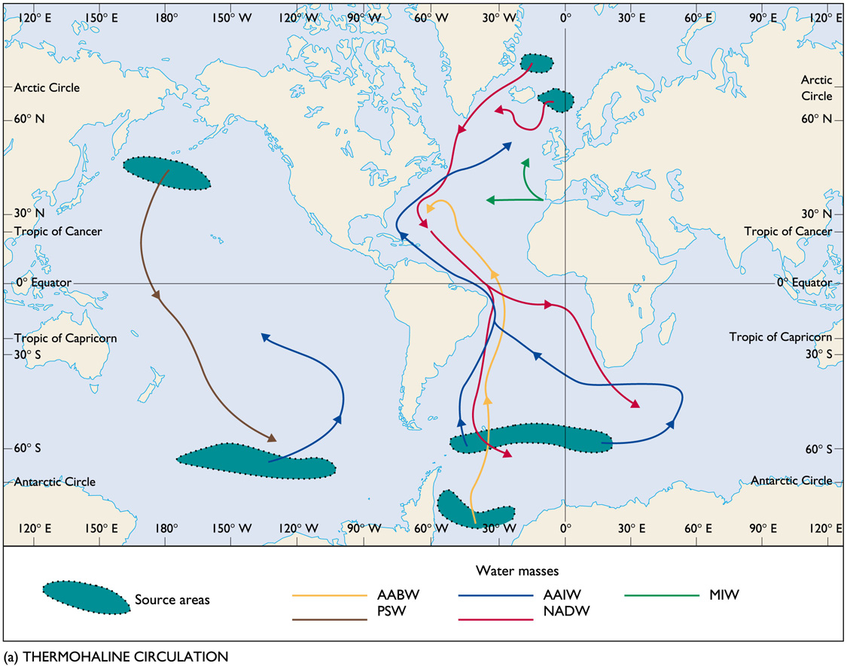

Slide 42
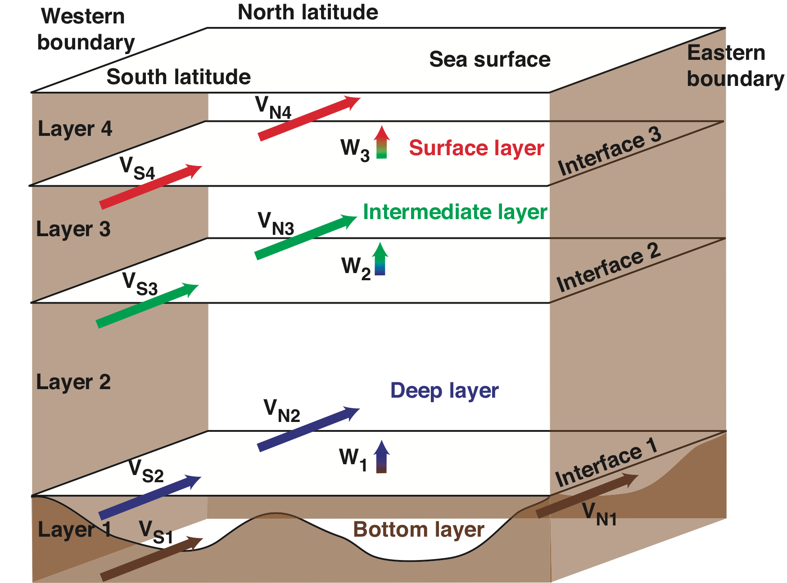
Calculation of meridional overturn
Use a zonal, coast-to-coast, top-to-bottom section
Compute meridional geostrophic velocities, and estimate meridional Ekman transport
Calculate zonally-integrated transports in layers (isopycnal layers or pressure layers).
Add Ekman transport to top layer.
Total transport through section should equal any leakages (such as about 1 Sv for Bering Strait)
Notes:
From atlantic deep llecture

Slide 43
Calculation of meridional overturning
(1) Total Mass transport in layer = 0
(2) Total vertical transport through interfaces calculated as difference between meridional transports and underlying vertical transport
(3) Vertical velocity (average) = vertical transport divided by area of interface
Equation 14.1
(1) M_{Ti} = V_{Ni} - V_{Si} + W_{i-1} - W_{i} = 0
(2) W_{i} = V_{Ni} - V_{Si} + W_{i-1}
(3) w_{i} = W_{i}/A_{i}

Slide 44
Calculation of meridional overturning
Example:
(1) V_{S1} = 5 Sv of AABW moves northward through south face into bottom layer
V_{N1} = 4 Sv of AABW moves northward out of north face
(2) Therefore W₁ = 1 Sv of AABW must upwell into the next layer above.
(3) If the area of the interface is 4,000 km x 1,000 km, the average vertical velocity is
w₁ = (1x10⁶ m³/sec)/(4 x 10¹² m²) = 0.25x10⁻⁶ m/sec = 0.25x10⁻⁴ cm/sec
Equation 14.1 (corrected sign)
(1) M_{Ti} = V_{Ni} - V_{Si} + W_{i} - W_{i-1} = 0
(2) W_{i} = -(V_{Ni} - V_{Si}) + W_{i-1}
(3) w_{i} = W_{i}/A_{i}
DPO Fig. 14.5

Slide 45
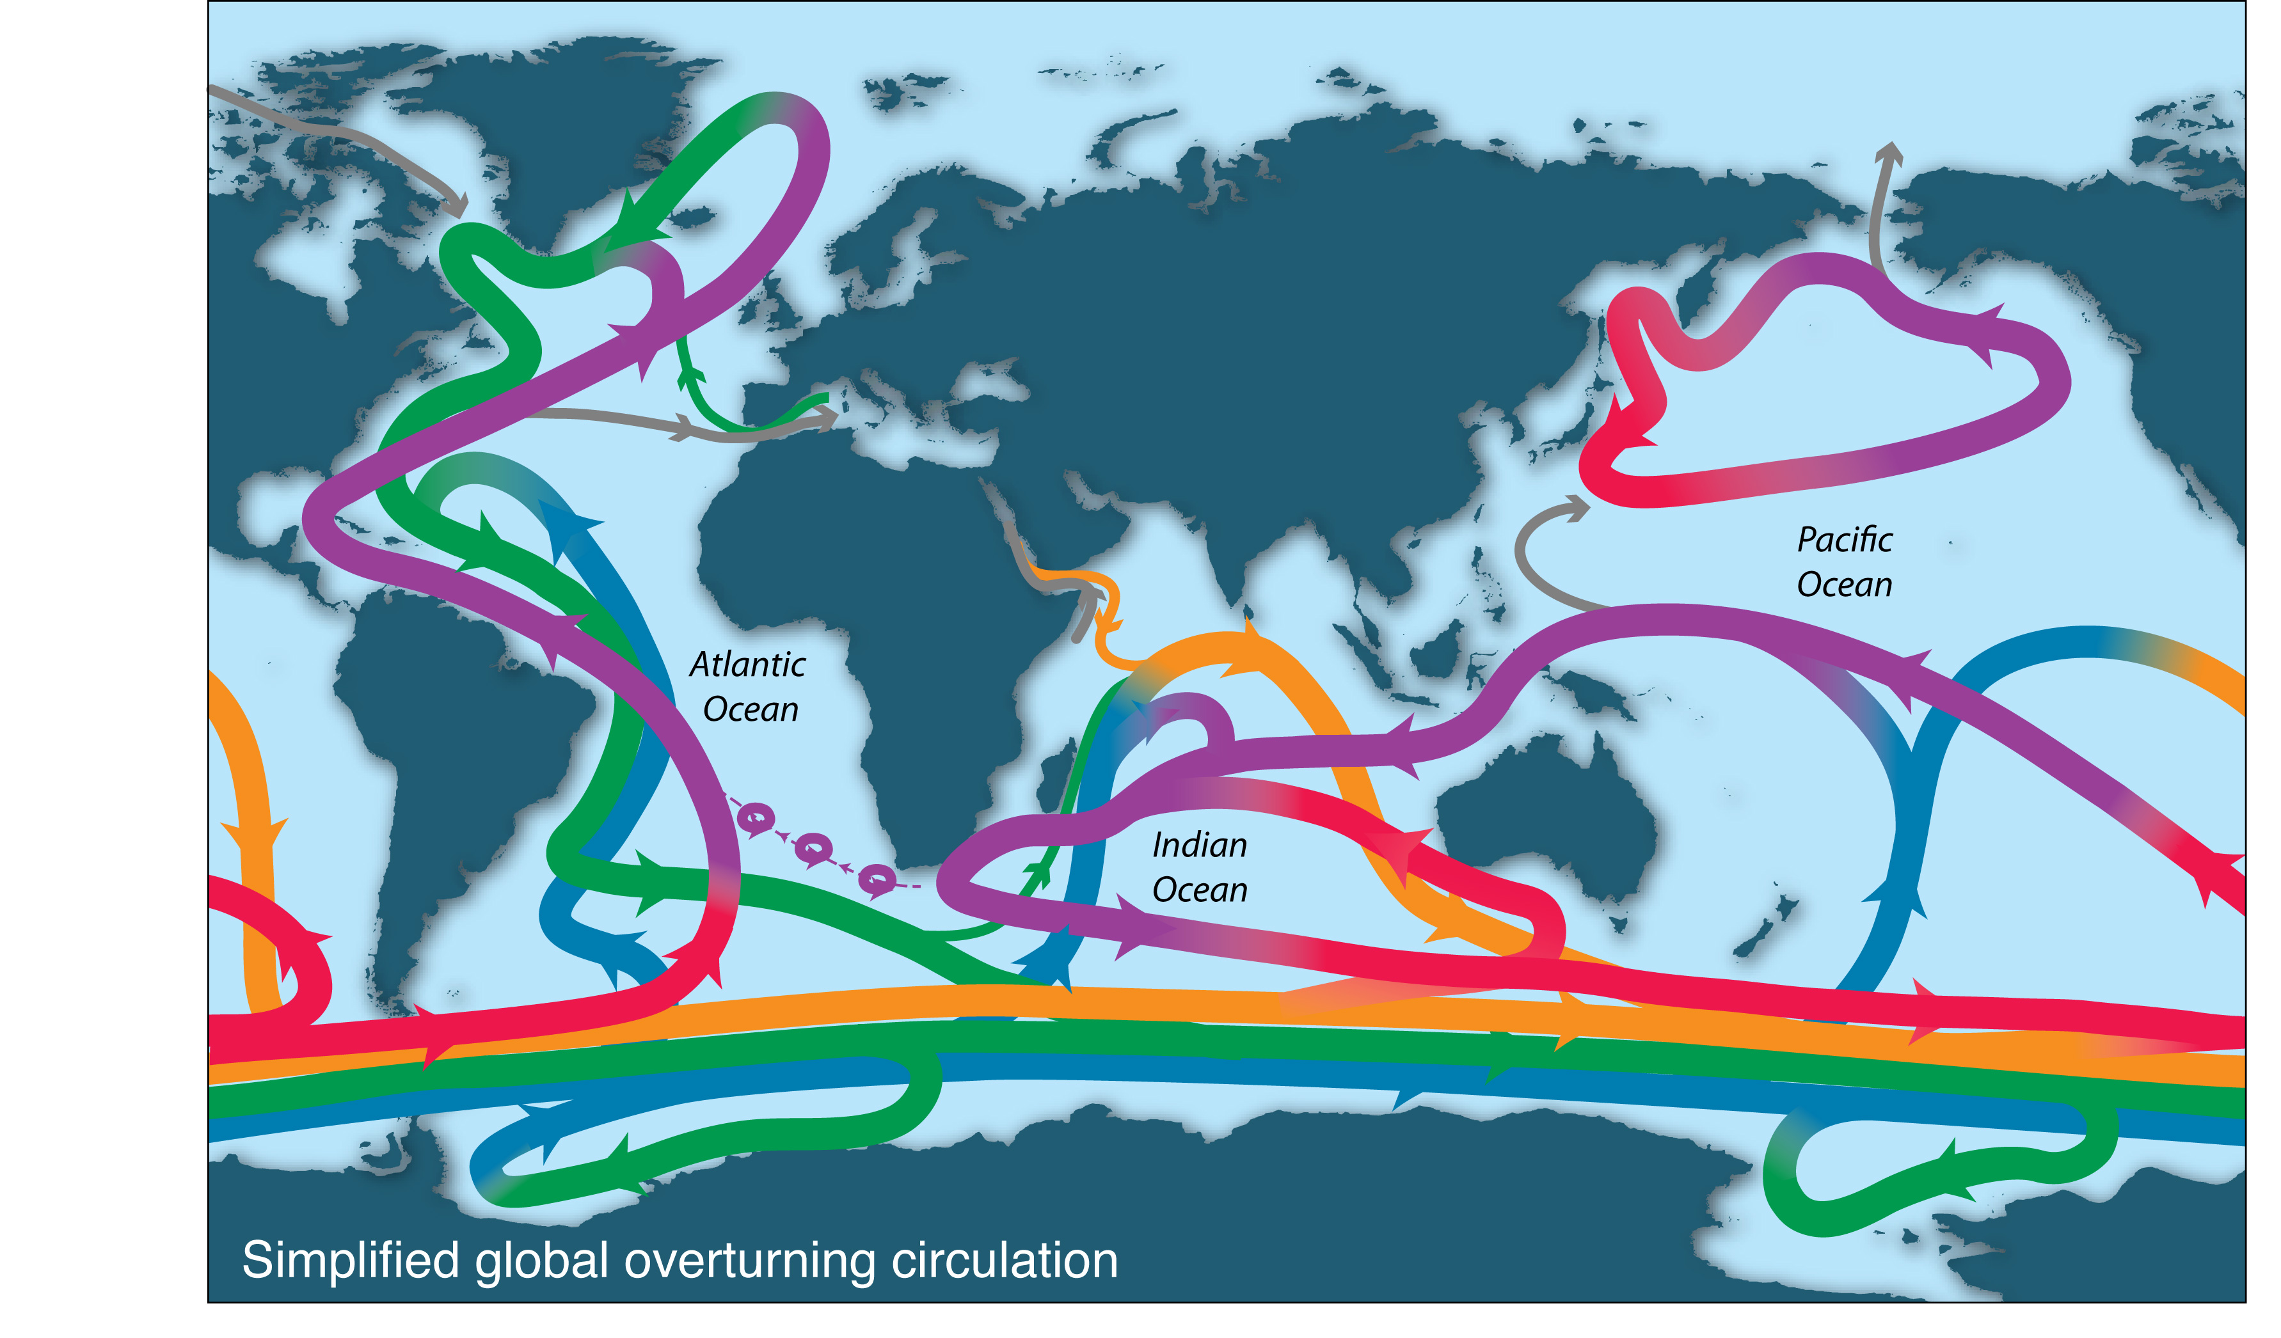
Global overturning schematic
More complete view based on major water mass transformations and quantitative overturning transports

